Slide 1

Chicago Taxi Usage Analysis
Lavanya Telapudi

Slide 2
Introduction
Drastic reduction in traffic volume has been observed worldwide and across the United States during the pandemic.
This event provides us with a unique opportunity to investigate the changes in travel using taxi prior and during the pandemic.
Collected and analyzed trip-by-trip taxi usage data from the City of Chicago spanning from 2014 to 2020.
The results show that the use of taxis in Chicago has been on a steady decline for multiple years.
However in March-2020, we observed a steep decline in the number of trips.
The number of trips had a sharp decrease which was mainly due to Covid-19.

Slide 3
Problem Statement
What changes COVID-19, and the dramatic drop in human activities associated with COVID-19, have had on the taxi industry?
We know that COVID has affected the taxi usage but the extent of it was not known.
Investigate the changes in taxi usage travel with regard to the number of total trips, trip travel times, trip distances and location.

Slide 4
Dataset
Link to the dataset: https://console.cloud.google.com/bigquery?p=bigquery-public-data&d=chicago_taxi_trips
Source: City of Chicago
Total rows = 187 Million rows
TAXI_ID is encrypted
Trip times are rounded to the nearest 15 minutes
Latitude and longitude columns are not accurate pickup and dropoff locations, but they are accurate to the street level to help with analysis.

Slide 5
Methods
The dataset is available on Google Cloud BigQuery as part of public data sets
Used the BigQuery SQL language to work with the data.
Data Clean-up
EDA
Comparing the data over the years in terms of number of trips, distance, location
Geospatial Visualization (geopandas)
Predictive analysis

Slide 6
Data Cleanup
Trip end dates are missing for few of the trips
YEAR | COUNT | MIN TRIP SECONDS | MAX TRIP SECONDS
2014 | 5869 | NaN | NaN
2015 | 3591 | NaN | NaN
2016 | 2414 | NaN | NaN
2017 | 662 | NaN | NaN
2018 | 350 | NaN | NaN
2019 | 545 | NaN | NaN
2020 | 574 | NaN | NaN
Notes:
This table shows the number of records for each year that were missing trip end dates

Slide 7
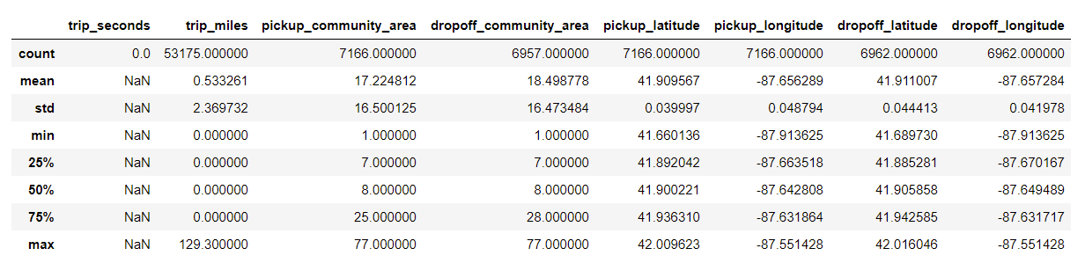
Data Cleanup
2. Trip end dates are less than trip start dates.
As we can see below most of other information is also missing or zeros, and there is no common data point.

Slide 8
Data Cleanup
3. There are trips which are lasting more than three hours which is not expected as we are only dealing with records which happened inside Chicago
4. The minimum fare for a trip should be $3.25. We will remove the records with trips fare less than $3.25.
5. Trip records with community area ids NULL are being dropped from final data. As per the data set description community area ids are NULL for those trips which happened outside Chicago.
6. The actual data set includes data from 2013- JAN to 2021- MAR, we are ignoring 2013 and 2021 data as the data is missing for most of the fields for 2013 and it is incomplete for 2021.
7. Trips less than 100 miles are only considered as longest route within chicago is only 50 miles.

Slide 9
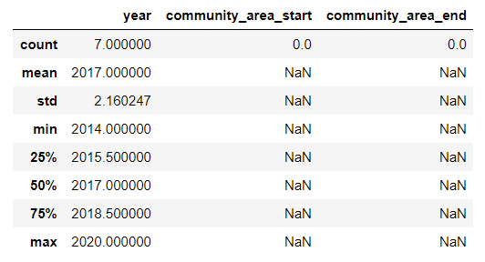
Data Cleanup
8. Pickup latitude and longitude are null for 18M records, which is nearly 20% of the data, the entire data set consists of 170 Million records for the years 2014 to 2020. These data is missing community area information as well. These must have happened outside Chicago as per the dataset description.

Slide 10


Slide 11
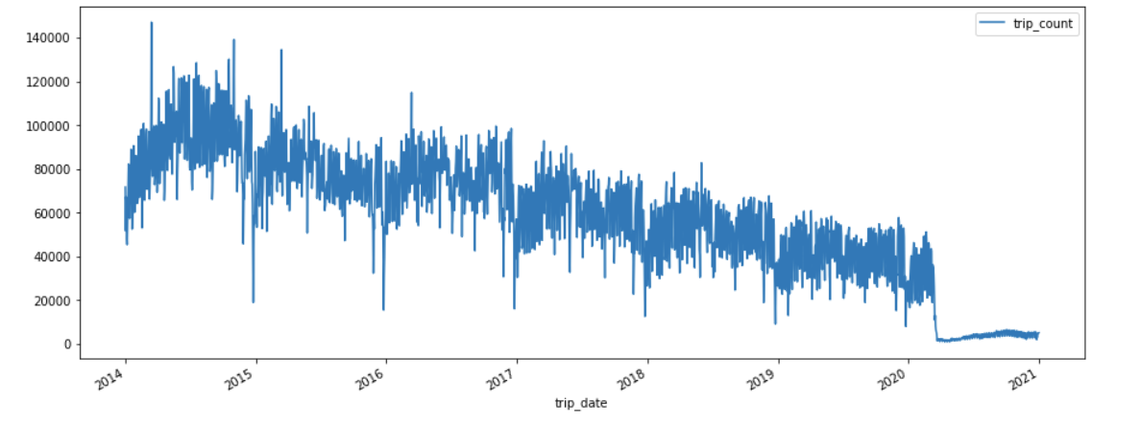
Results
Change in the number of trips over the years from 2014 to 2020. The graph looks linearly decreasing until 2020.

Slide 12
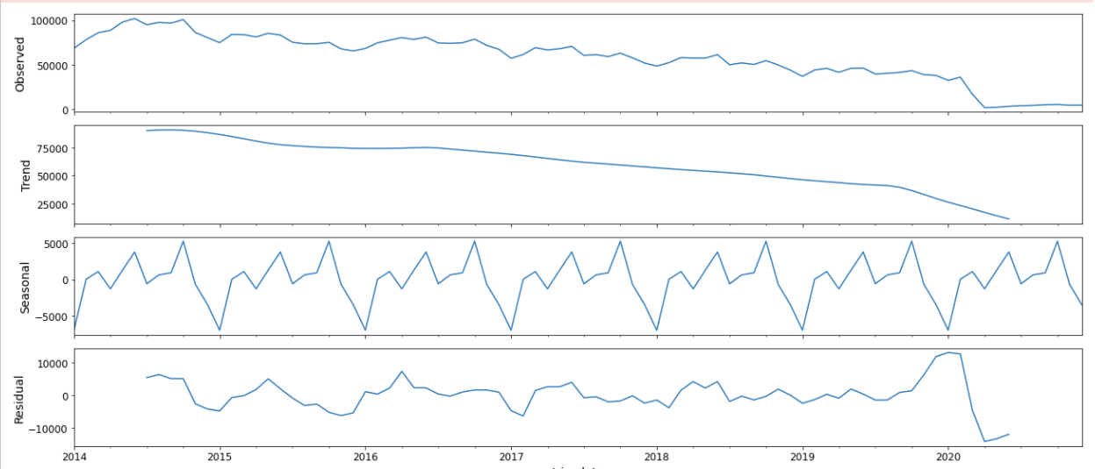
Results
The trend is almost linear before 2020 and we can see that there is seasonal behavior.

Slide 13
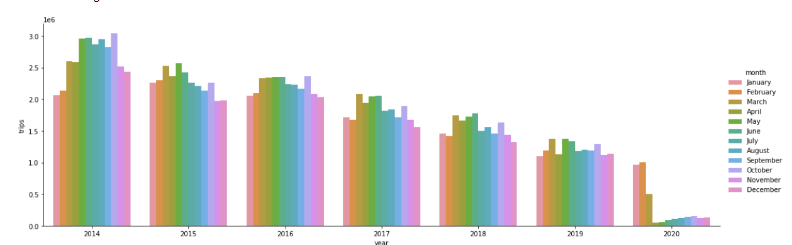
Results
The number of trips per month from 2014 to 2020

Slide 14
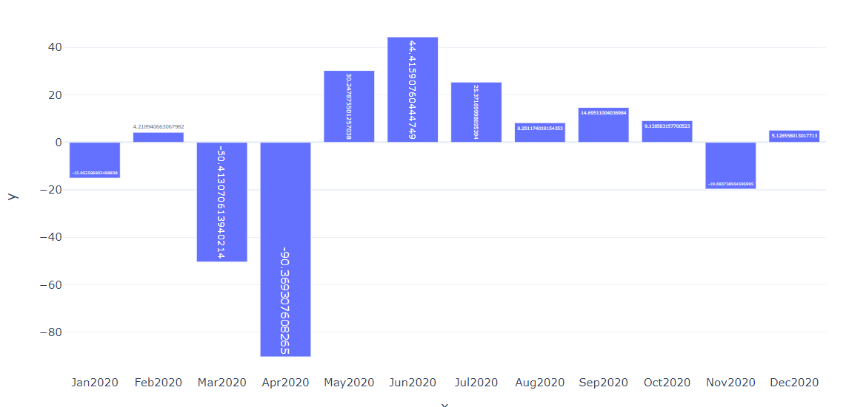
Results
Percentage of trips during 2020 from Jan to Dec.

Slide 15
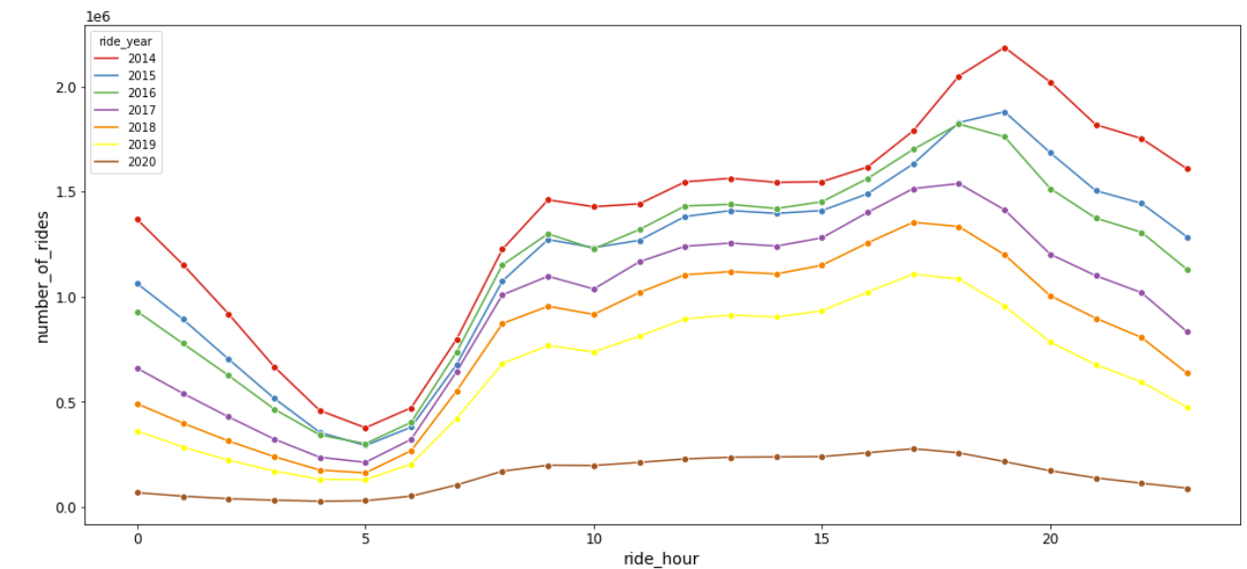
Results
Hourly representation of rides for one day

Slide 16
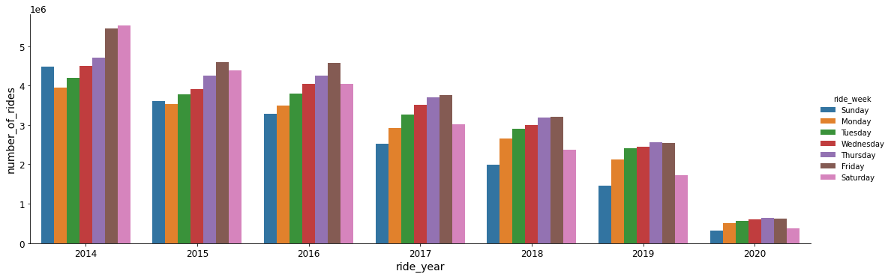
Results
Weekly representation of the rides.

Slide 17
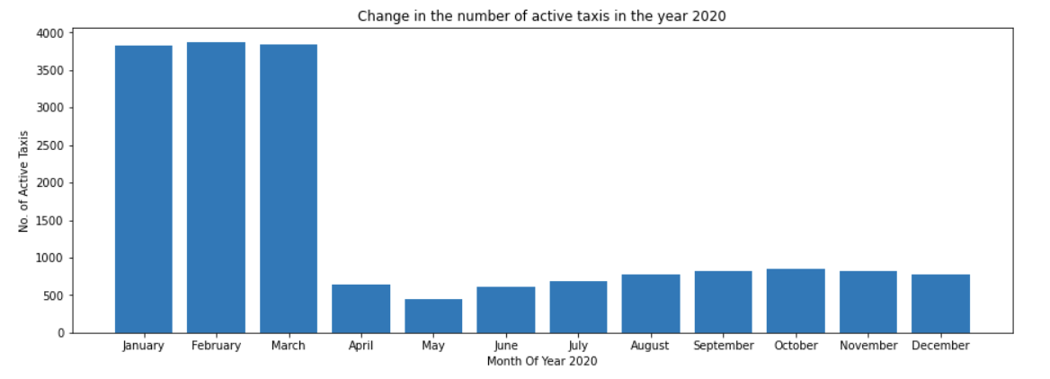
Results
Not just the number of trips, but number of taxis that are active are also reduced in number.

Slide 18
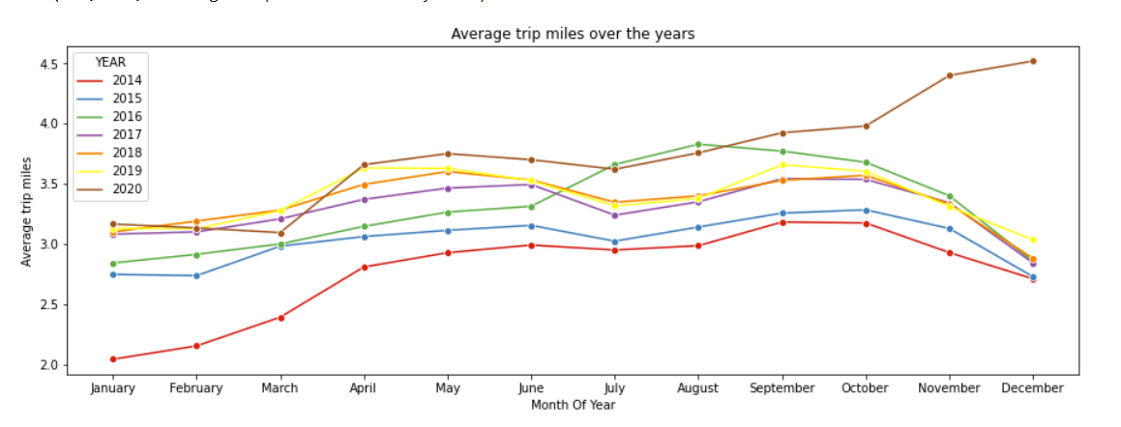
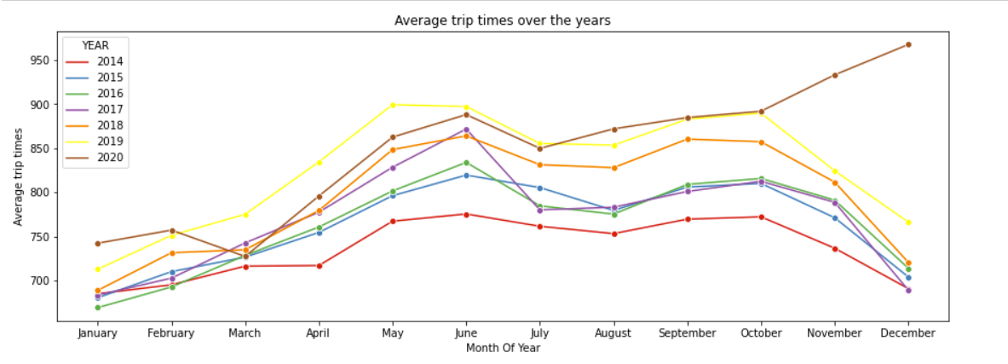
Results
Average distance of trips is more during the pandemic but there is not much difference in the travel times.

Slide 19
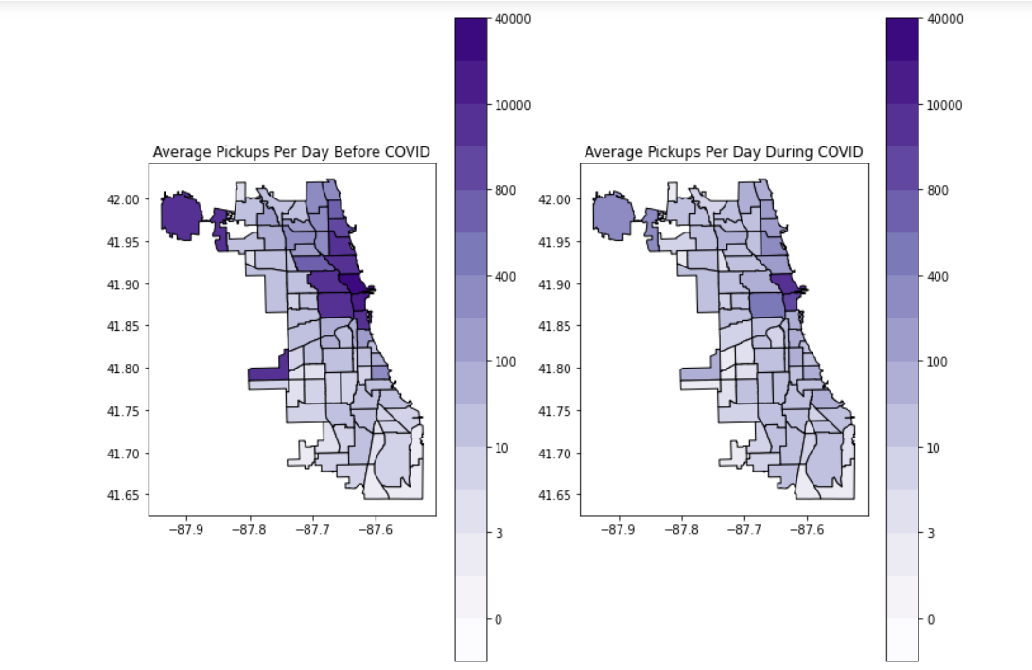
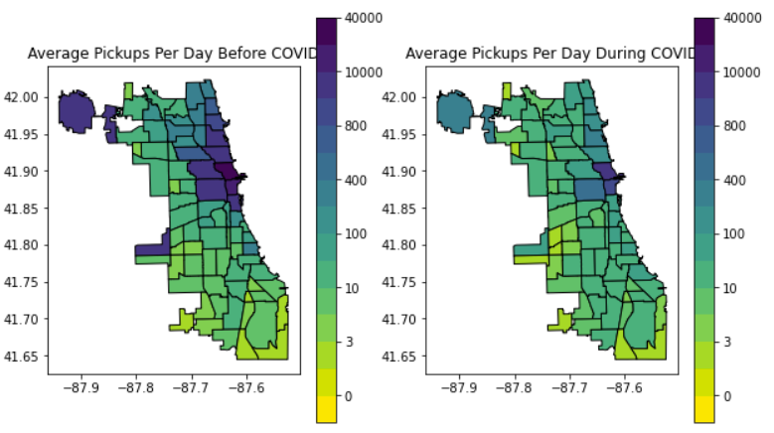
Results
O’Hare airport pickups are most impacted.
Central city still remained most popular.
There is not much impact in the Far Southeast side of the city. In Fact there is increase in the number of pickups in these locations.

Slide 20
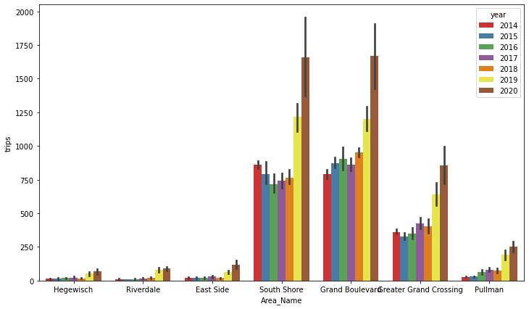
Results
South Shore, Grand Boulevard, Greater Grand Crossing have considerable increase in the number of pickups during covid compared to previous years. Thought the number of trips is increasing in these areas, number of active taxis has been reduced.

Slide 21
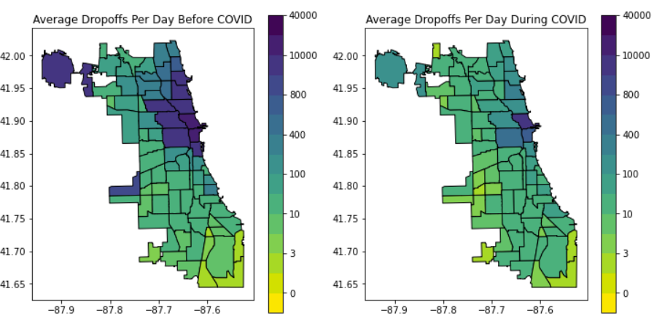
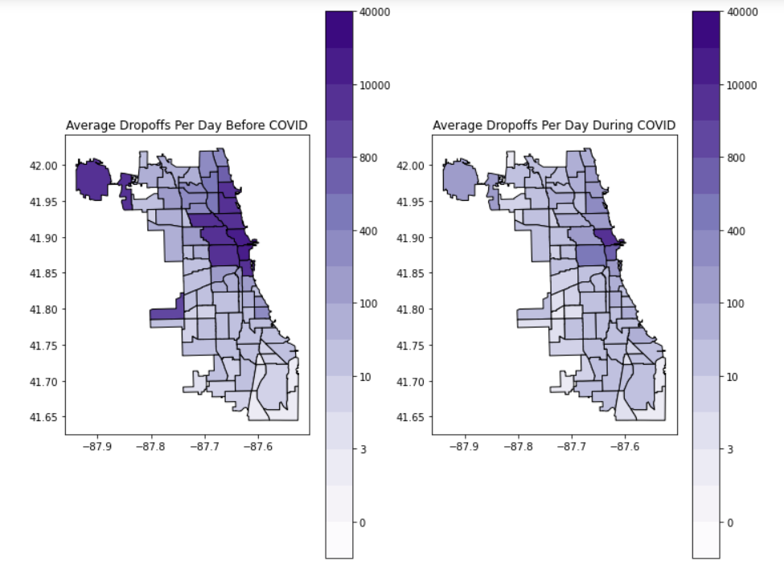
Results
Similar behaviours is observed for drop-off locations as well.

Slide 22
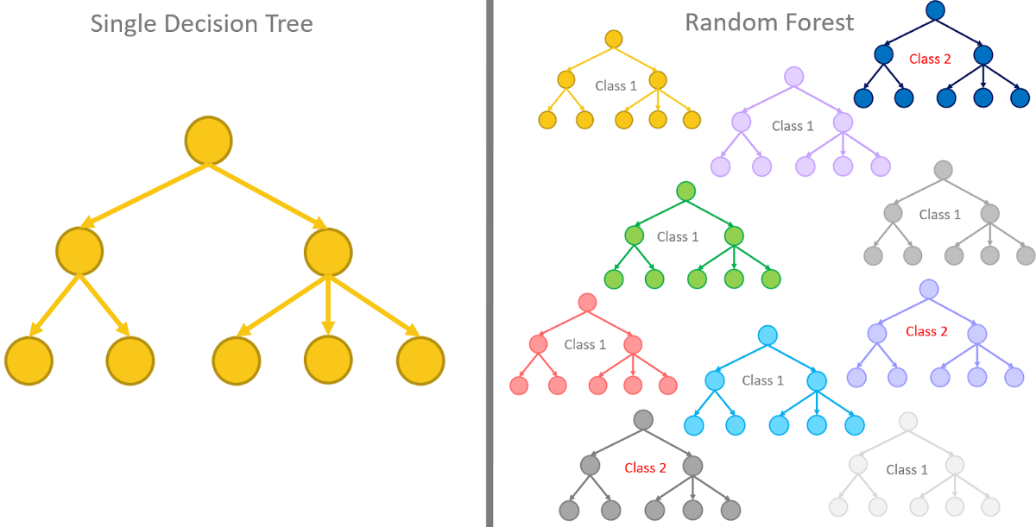
Random Forest And Decision Tree Model

Slide 23
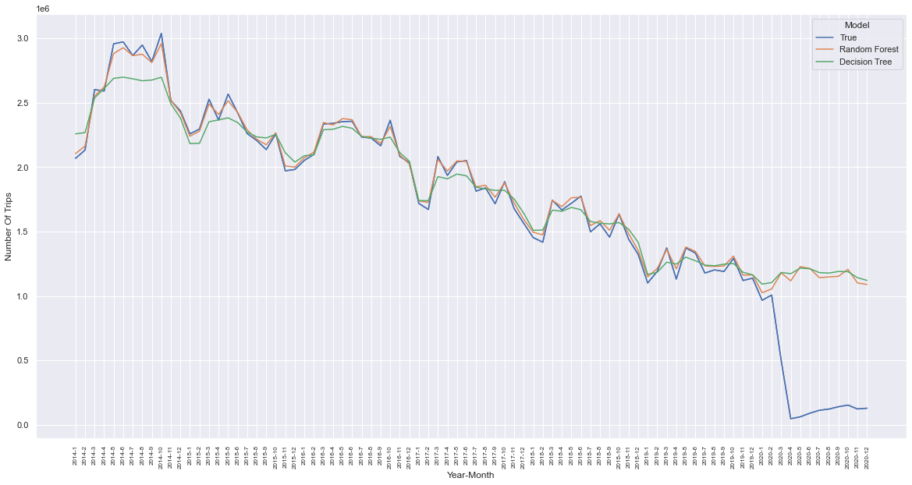
Results
Using Random Forest and Decision Tree to predict the trend of trips for 2014 to 2020 and compare to the actual trend for those years. The predicted results from both models are similar to the actual results until March 2020.

Slide 24
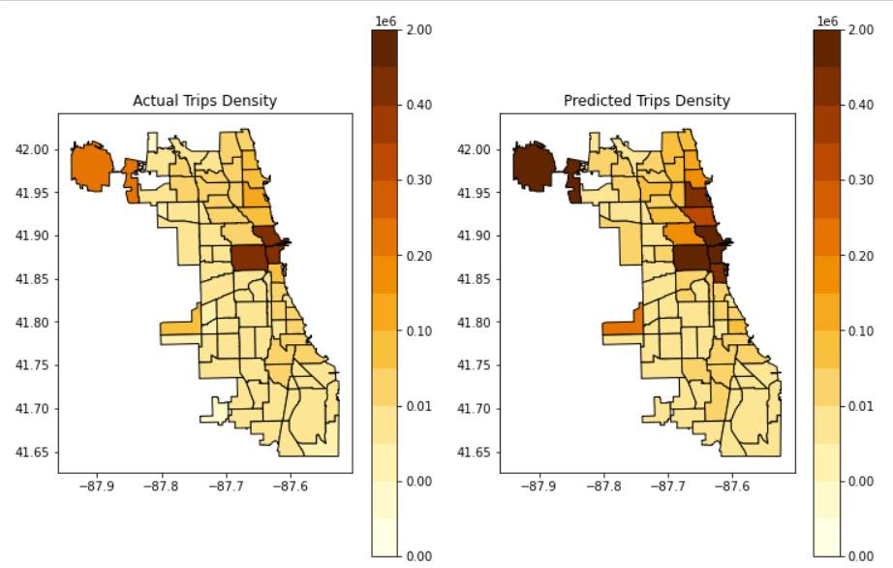
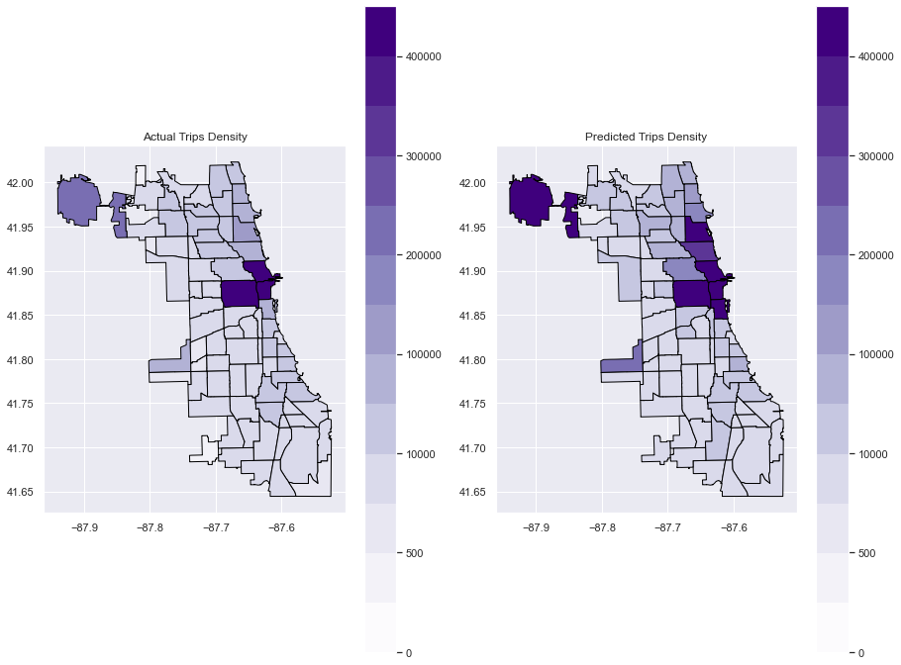
Results
Density Comparison Map for Predicted vs True

Slide 25
Conclusion
There was an overall decrease in the number of taxi trips in 2020 due to Covid-19. There were some places in Chicago where there was an increase in trips an, not just in 2020 but for the past several years, but these were low density regions where the number of trips is still less than 2000 per month. According to the predictions, there was supposed to be a steady number of trips in 2020, with no overall decline or increase. However, due to the pandemic, there was a sharp decrease. It was expected to have an average of 1 million trips but instead had an average of 200,000 trips.

